Slide 1
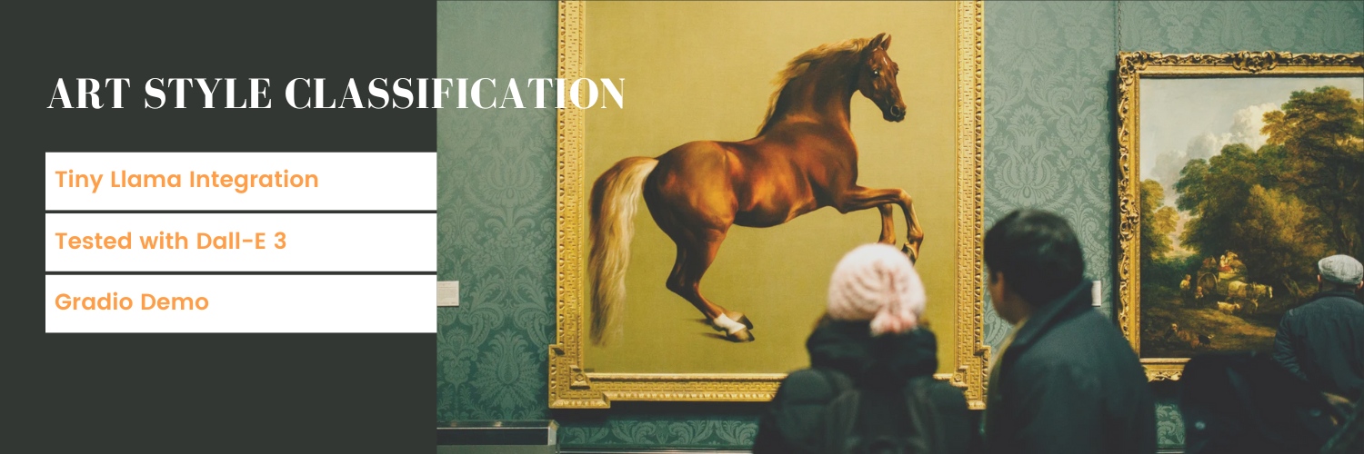

Slide 2
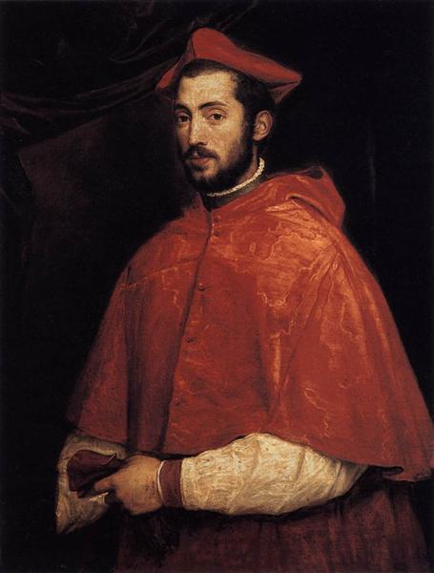
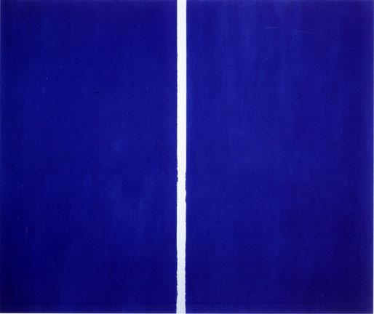
Project Overview
Develop an AI model that automatically and classifies artwork by artistic style or movement
Combine computer vision (CNN) with natural language processing for comprehensive art analysis
Successfully differentiate between 26 distinct art movements
Testing using AI-generated art (DALL-E 3) to evaluate model flexibility

Slide 3
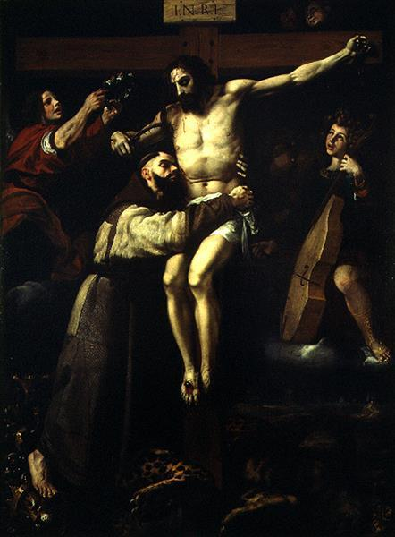
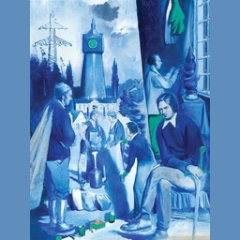
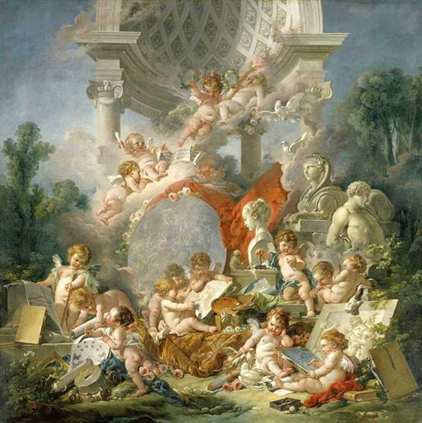
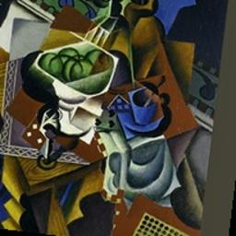
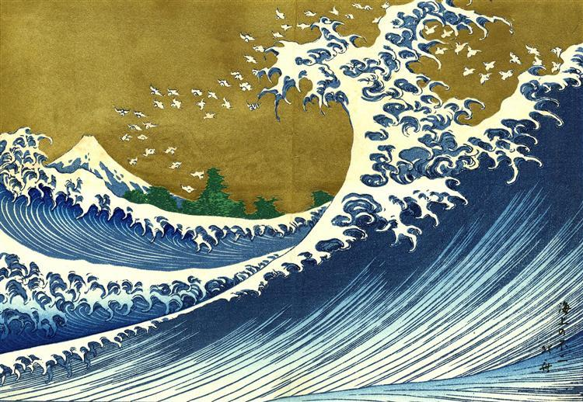
Data Collection
Preprocessing
CNN
Tiny Llama
Gradio

Slide 4
Data Collection
Styles
naive_art
baroque
rococo
romanticism
art_deco
american_realism
art_nouveau
expressionism
modernism
post_impressionism
high_renaissance
cubism abstract_expressionism
art_informel
mannerism
northern_renaissance
surrealism
symbolism
early_renaissance
neo_romantic
ukiyo_e
impressionism
pop_art
fauvism
neoclassicism
minimalism
Sources
Wikiart
Art Institute of Chicago
Artsy
Challenges
Unable to search API by ‘style’ terms.
API rate limiting
Final Imageset
Sourced entirely from Wikiart
Large, diverse Collection
Searched by curated artist list
More balance

Slide 5
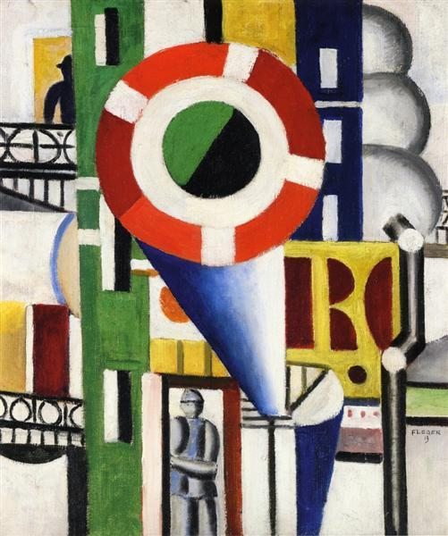
EDA and Image Processing
EDA
Checking for duplicates
Checking for legit files
Curating
Filtering
Augmentation
Conservative Augmentation
Resize while maintaining
aspect ratio (256, 256)
Mean color padding instead of black
Color Adjustments
Horizontal flip
Random cropping (80% of original size)
Gentle rotation (±10 degrees)

Slide 6
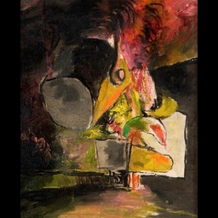
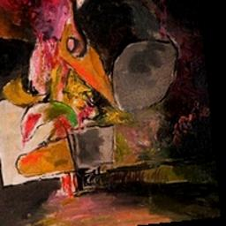
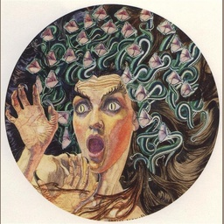
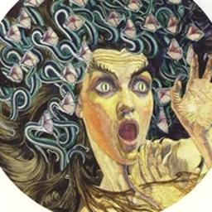
Image Augmentation
‘Foundry, Ladle Feeding Furnace’
Graham Sutherland, 1941
Neo-Romantic
‘Medusa’
Carlos Schwabe, 1895
Symbolism

Slide 7
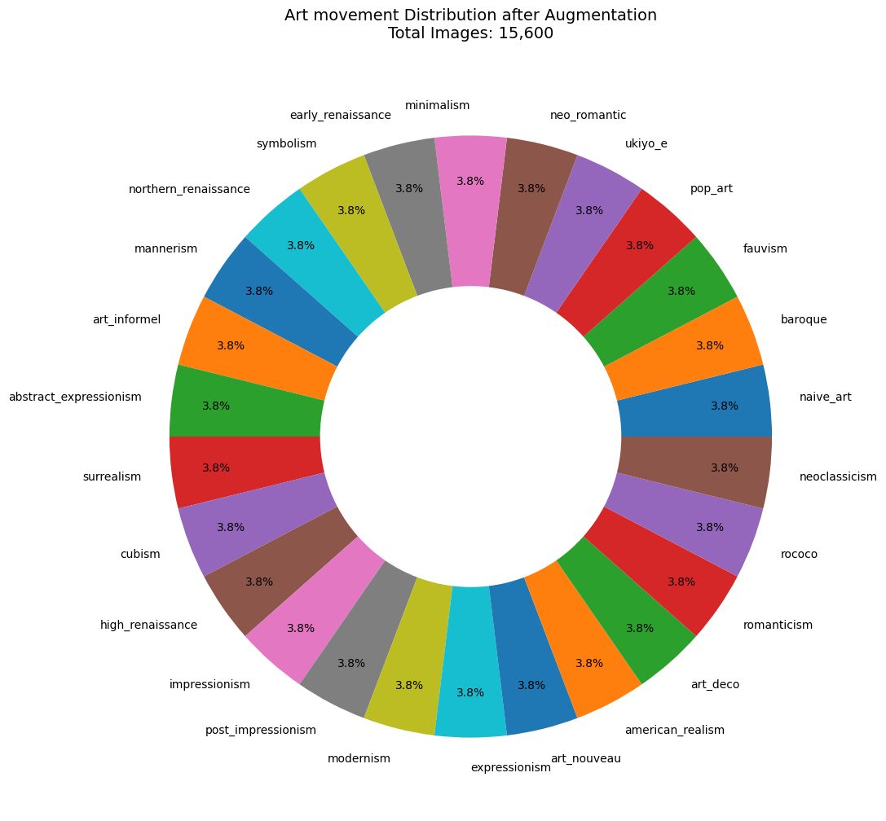
26 Classes
600 Images
per Class

Slide 8
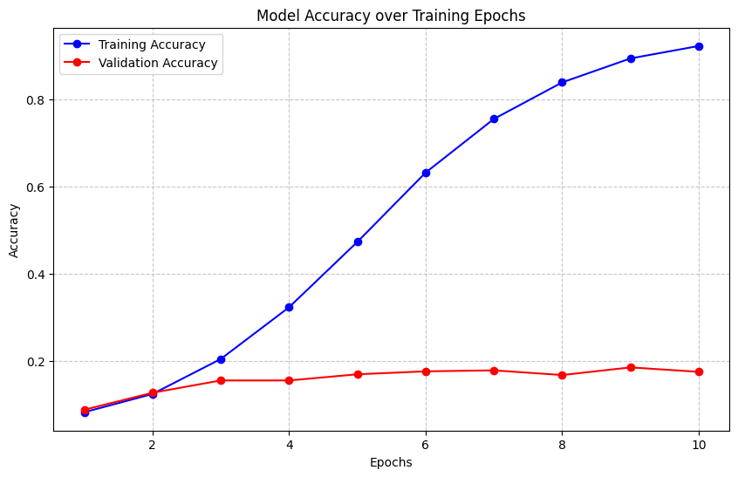
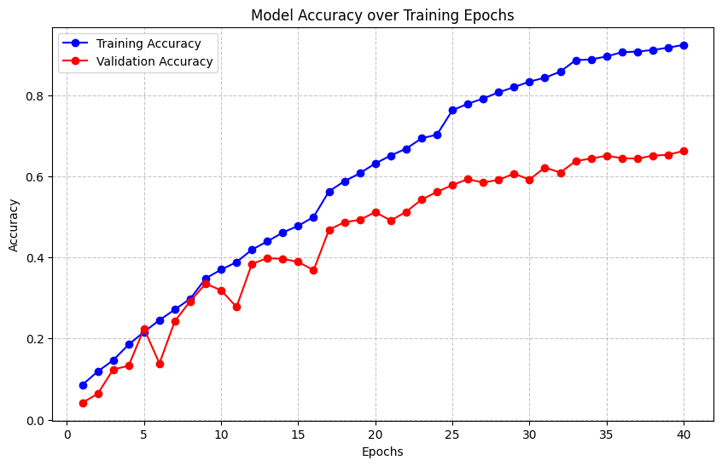
CNN Training and Evaluation
Overfitting!
Improvements: More Conv2d layers, more filters per layer, GAP (Global Average Pooling) instead of flatten() layer, BatchNormalization() layers, increased epochs, learning rate schedule, early stopping, SE Blocks

Slide 9
CNN Architecture
Model Architecture
4 Convolutional Blocks (64→128→256→512)
Squeeze-Excite attention blocks
Global Average Pooling
Dense layers (256 units)
26-class softmax output
Training Strategy
Optimizer: Adam
Initial LR: 0.001 (0.5 drop/8 epochs)
Batch size: 64
Early stopping (5-epoch patience)
Max epochs: 40
Key Features
L2 regularization (0.0001)
Progressive dropout (0.2→0.25→0.3→0.4)
Batch Normalization
Label smoothing (0.1)
Squeeze-Excite (SE) Blocks: Attention mechanism that adaptively recalibrates channel-wise feature responses
"Squeeze" - Global average pooling to capture channel-wise dependencies
"Excite" - Two fully connected layers learn to generate channel-wise weights
Final Performance
• Test accuracy: 65.41%
• Strong performance given:
26 distinct classes
- Complex style classification
- Overlapping characteristics

Slide 10
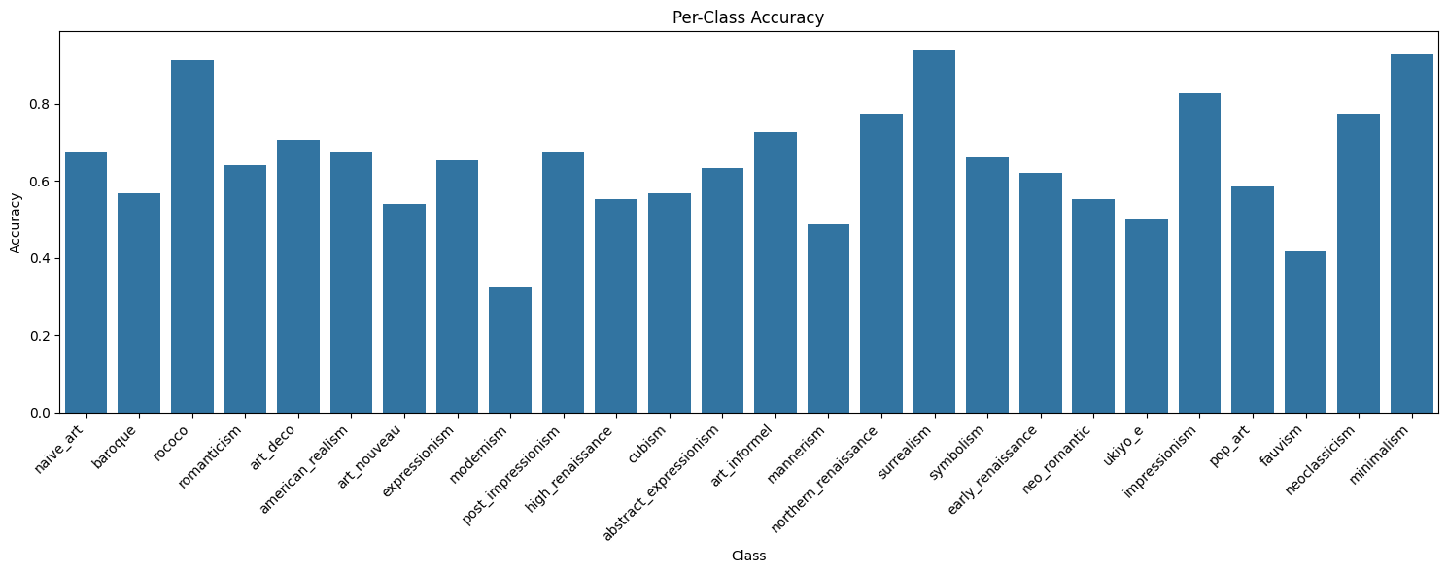
Top 5 Misclassifications:
1. True: naive_art → Predicted: art_informel (Count: 20)
2. True: cubism → Predicted: ukiyo_e (Count: 17)
3. True: abstract_expressionism → Predicted: high_renaissance (Count: 17)
4. True: art_nouveau → Predicted: mannerism (Count: 16)
5. True: art_informel → Predicted: naive_art (Count: 16)

Slide 11

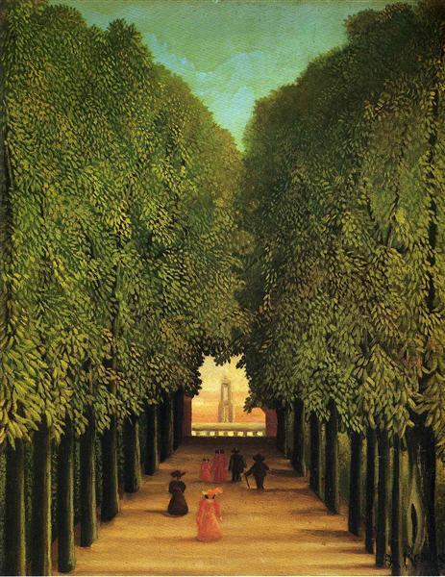
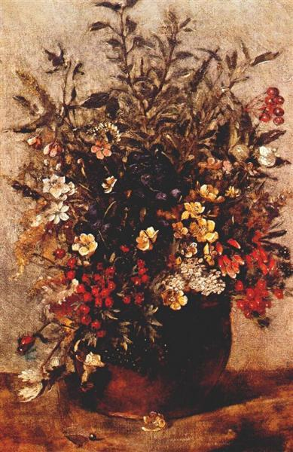
Tiny Llama

Slide 12
Language Model
Selected TinyLlama-1.1B-Chat
Manageable model size
Reasonable inference speed
Coherent response generation
Classify the question
Technique queries (how, method, style characteristics)
Historical queries (period, era, time)
Influence queries (impact, inspiration)
Output Processing
Response cleaning
Style-based language adaptation
Format standardization
Full Prompt: f"{system_message}\n{user_prompt}"

Slide 13
Gradio Interface
Input:
Image upload (jpg, png, webp support)
Text input for art-related questions
Analysis trigger button
Output:
Style predictions with confidence scores
Top 3 predicted styles
Language model response panel
Function:
process_and_analyze()
Takes array and question
Preprocesses image
Calls CNN model to make prediction
Calls lang model for response
Returns prediction (style) and response
Image Input:
gr.Image() - automatically converts uploaded image to np array
Returns BGR format (requires RGB conversion)
Handles multiple image formats (jpg, png, webp)

Slide 14

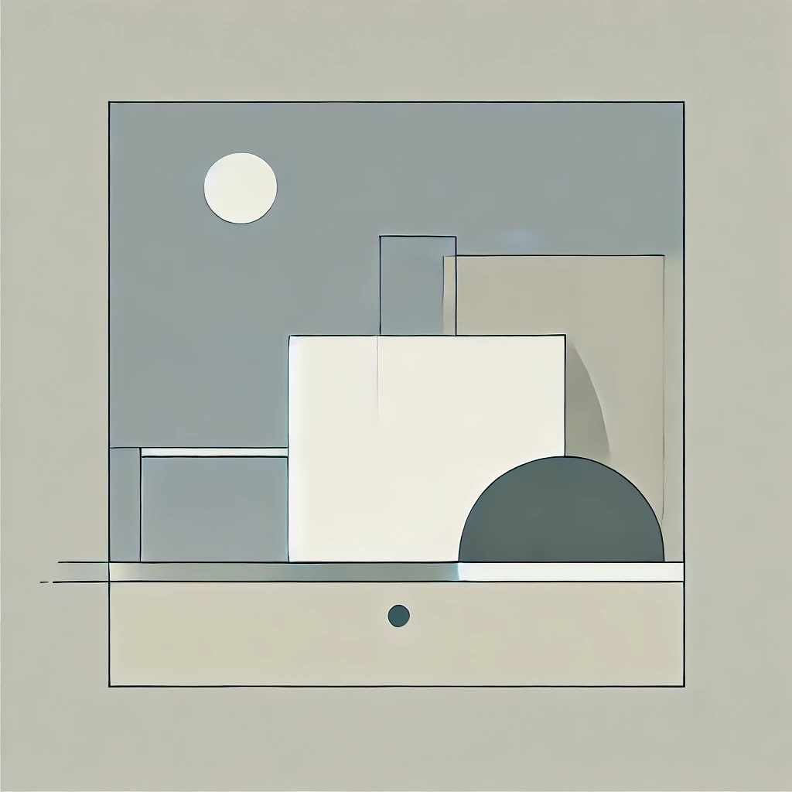
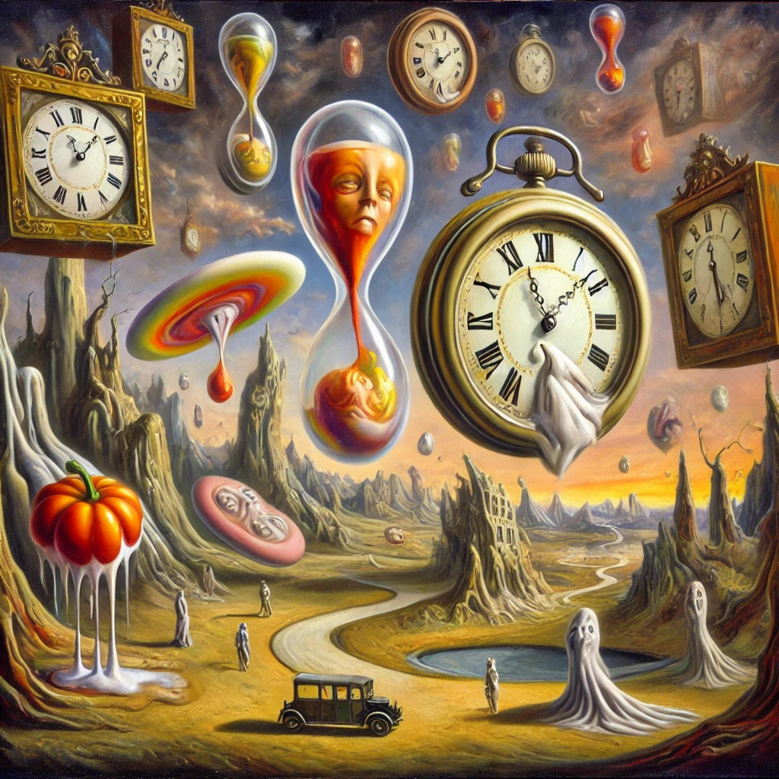
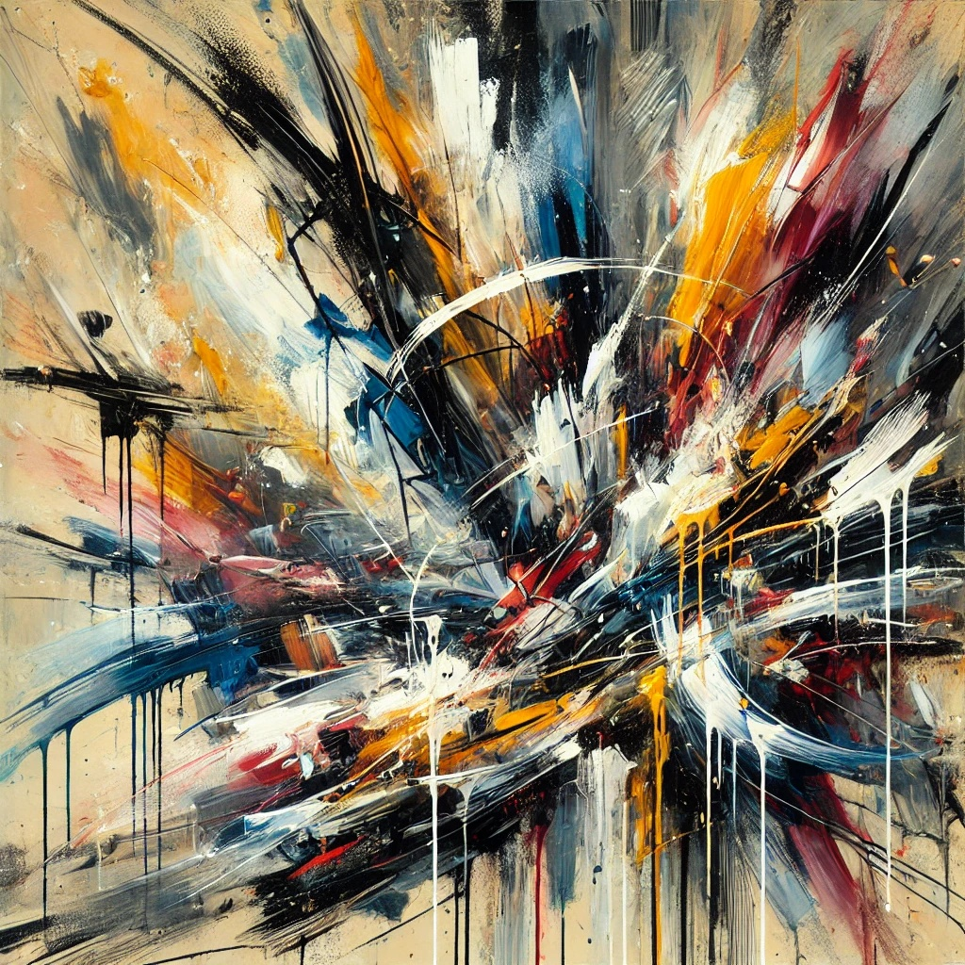




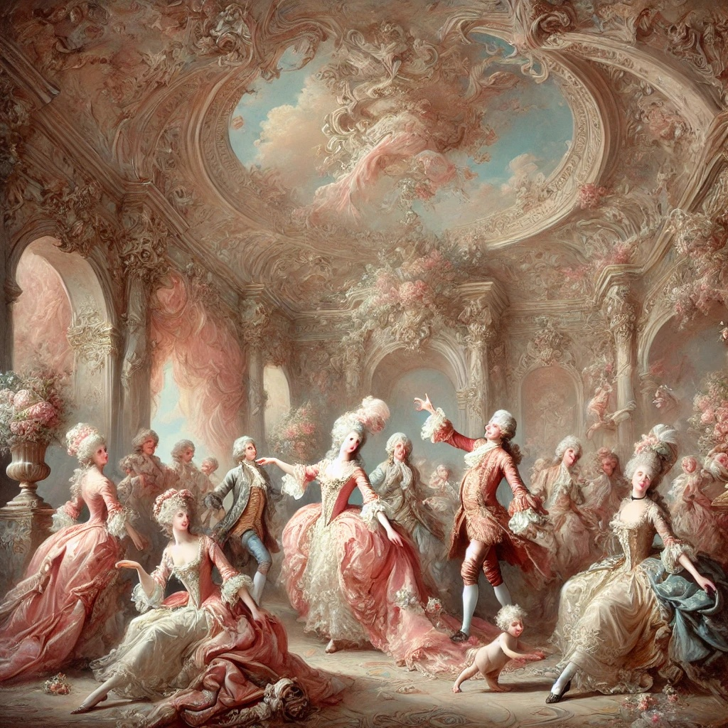

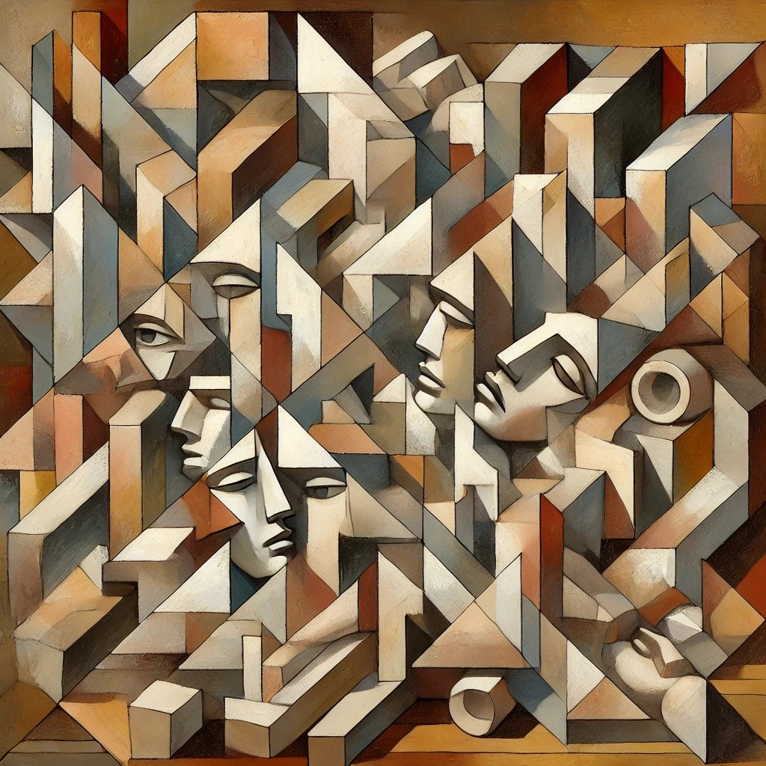



Dall-E 3 Generated Art
1 - Pop Art
2 - Minimalism
3 - Surrealism
4 - Abstract Expressionism
5 - Rococo
6 - Cubism

Slide 15
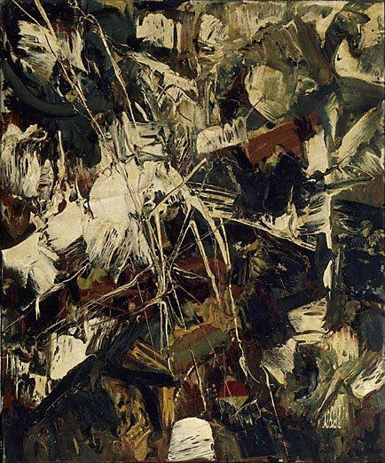
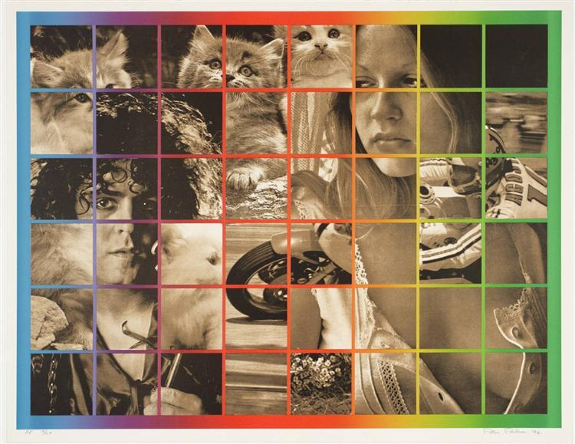
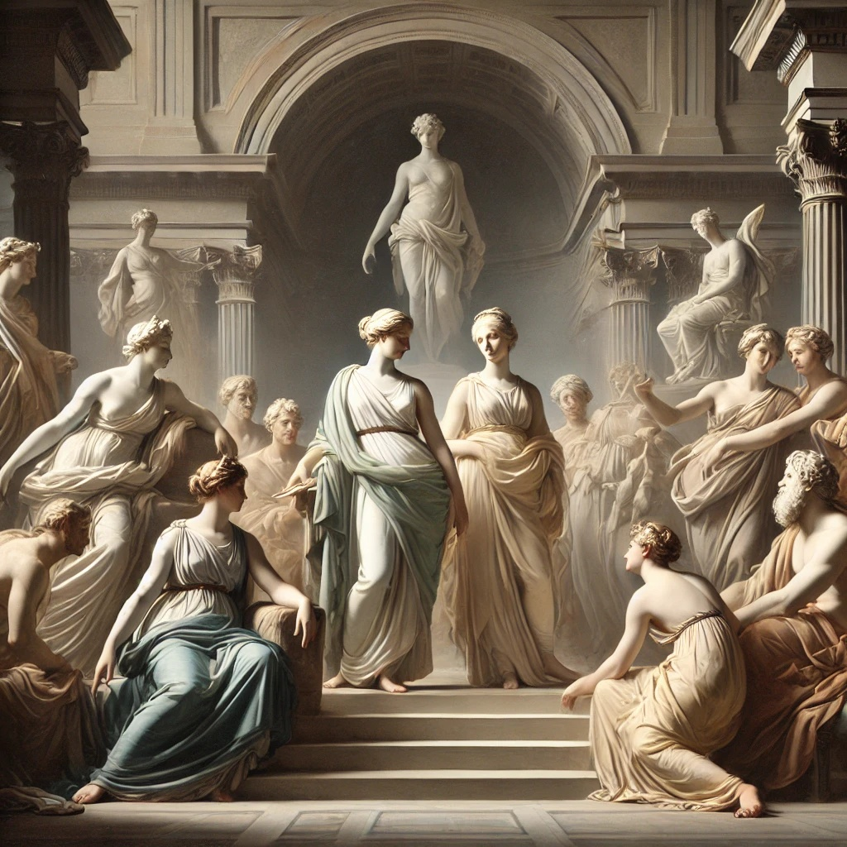
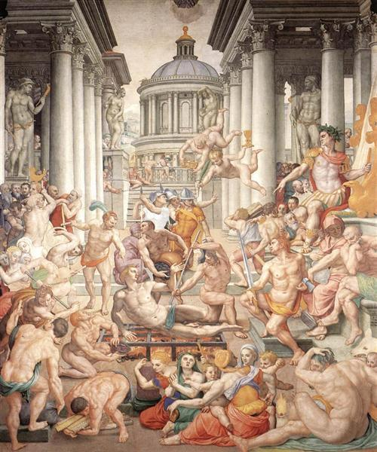
Dall-E 3 Art Comparison
Real Artwork from the predicted style:
Prediction/Label
1 )Art Informel/
Abstract Exp
2) Pop Art/
Cubism
3) Mannerism/
Neo-Classical
1) ‘Untitled’
Jean Paul Riopelle, 1949
2) ‘Six Times Eight, Dreaming’
Peter Phillips, 1974
3) ‘Martyrdom of St Lawrence’
Agnolo Bronzino, 1569

Slide 16
Results & Conclusions
Achievements:
Successfully classified 26 distinct art styles with 65.41% accuracy
Built end-to-end system combining:
CNN visual analysis
Language model interpretation
User-friendly interface
Validated model using AI-generated art (DALL-E 3)
Challenges:
Complex dataset curation and cleaning
Style overlap and ambiguity
Model overfitting
Balanced augmentation to preserve artistic integrity
Resource Constraints
Balanced lang model performance

Slide 17
Next Steps
Further training and hyperparameter optimization
Experiment with different architectures
Expand dataset with more diverse artworks
Refine style categories and subgenres
Augmented Reality (AR) Integration:
Real-time style analysis in museums
Educational AR applications
Mobile deployment
Museum guide integration

Slide 18
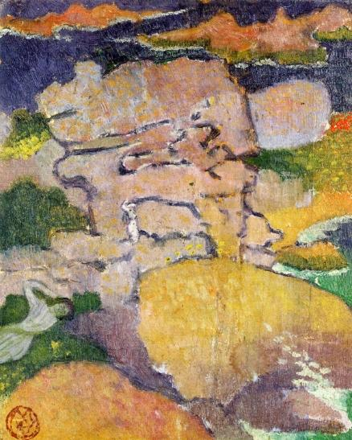
Q and A
Thank you!
https://github.com/piiop/final_project

